Slide 1
Parkinson’s Disease Progression Prediction
Javier Echavarren Suarez A20521368
Victor Boveda Prado A20521372
Carlos Castillo Martinez A20520708

Slide 2
Index
Problem understanding
Data analysis
Data preprocessing
Model selection
Results
Conclusions and pending tasks

Slide 3
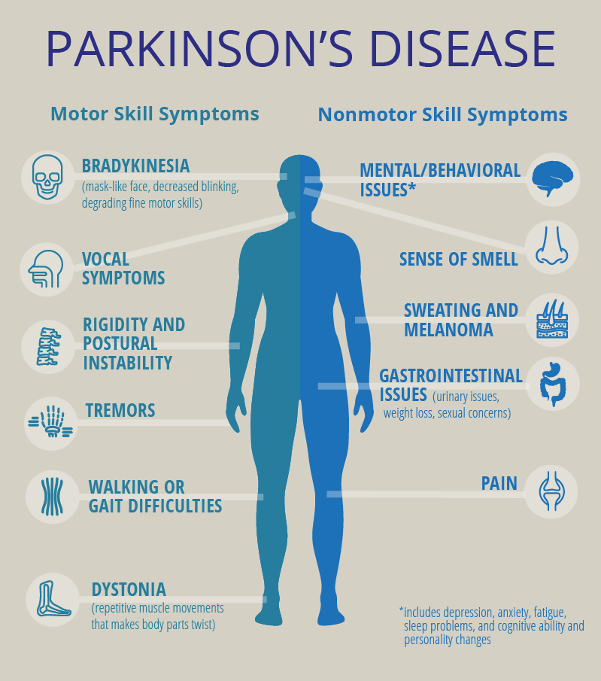
Problem understanding
Parkinson's disease affects movements, cognition, sleep, and other normal functions, with no current cure and worsening over time.
By 2037, an estimated 1.6 million people in the US will have Parkinson's disease, with an economic cost approaching $80 billion.
Research indicates that protein or peptide abnormalities play a significant role in the onset and worsening of Parkinson's disease.

Slide 4

Data science could provide important clues for the development of new pharmacotherapies to slow the progression or cure the disease.
Current efforts have resulted in complex clinical and neurobiological data on over 10,000 subjects for broad sharing with the research community.

Slide 5
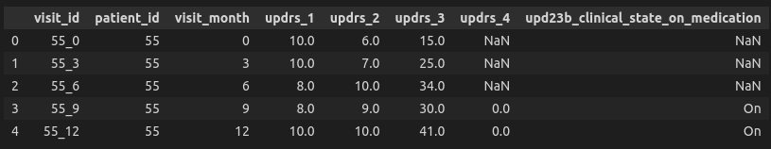
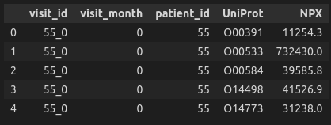
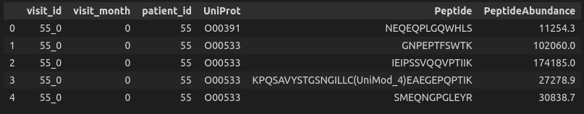
Data analysis
Three tables:
Train clinical:
Train protein:
Train peptide:

Slide 6
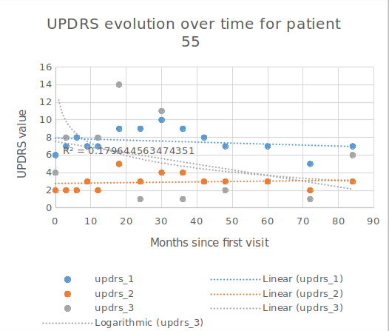
Plotting the evolution of symptoms over the weeks:
Does not increase
Small correlation (R squared is very small)

Slide 7
Data preprocessing
Several problems with data:
Bad format
Many tables
Nan values
Different order of magnitude between proteins

Slide 8
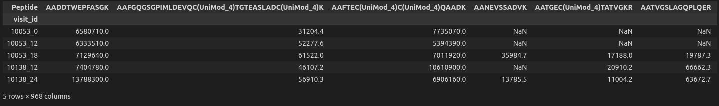
Bad format
We have to pivot the proteins and peptides tables in order to each protein is a variable:

Slide 9
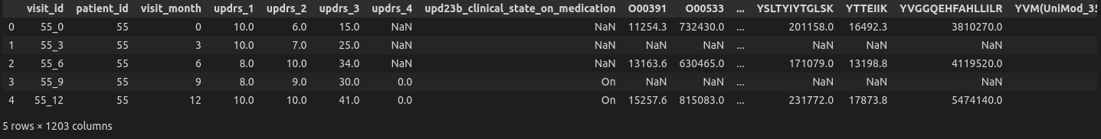
Many tables
We have to join the tables so we have all the data in one dataframe:
We merge the tables on the visit_id variable

Slide 10
Nan values
Interpolate the proteins/peptides missing values between visits
We set the symptoms missing values to 0
We use the mean for proteins/peptides that were not measured in a patient

Slide 11
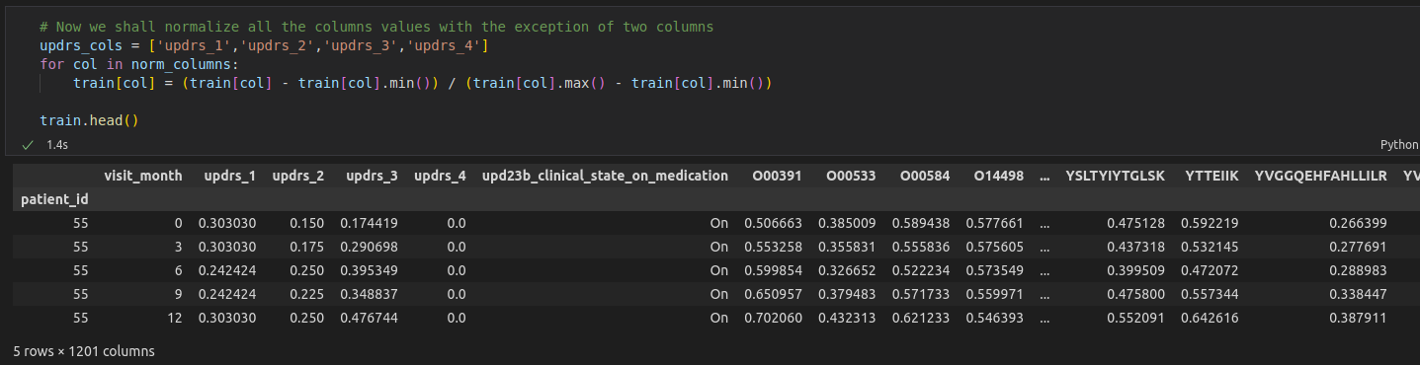
Different order of magnitude
We normalize every feature so they comprend values between 0 and 1.

Slide 12
Model selection
We have two models to select:
A model for predicting symptoms as a function of protein levels
We have a lot of features
One model per each symptom
Random forest
A model for predicting the evolution of the symptoms over time
Not the same visits for every patient
Symptoms does not evolve the same way in every patient
Linear regression

Slide 13
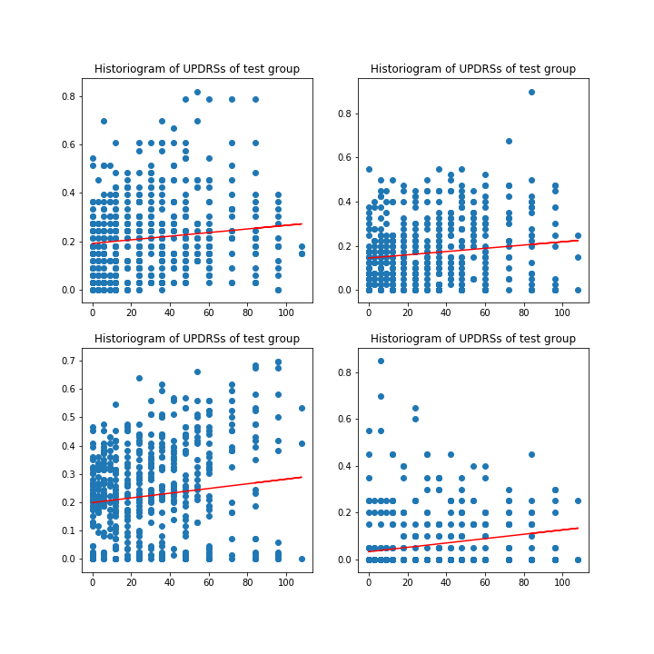
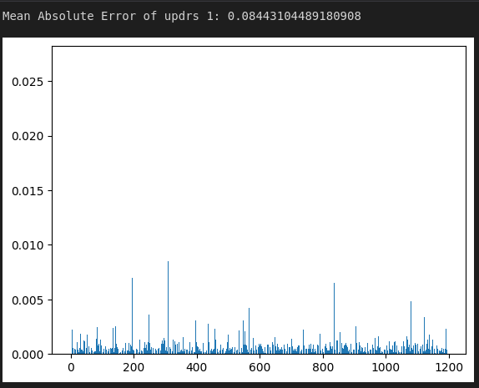
Results
Random forest
Linear regression

Slide 14
Conclusion
Good results for that many features and a reasonable running time
Proteins and peptides levels influence the symptoms levels
The evolution of the symptoms does not have a high correlation with the time

Slide 15
Pending tasks
Feature selection
Parameter hypertuning: improve the current models
Personalize the time regression: symptoms don’t evolve the same way in every patient
Create and submit a submission file

Slide 16

Questions?

